Slide 1
Tech Roadmap Update
October 2015

Slide 2

Tech Roadmap Oct. 2015
All projects assessed, project status reviewed weekly
Scale factor for multiple attributes including
Cost
Mass
Packaging
Performance
Rating scale considers trade offs between attributes
120 Total Active Projects
13.5% Value Improvement average over current state
Quality
Value Stream/Risk Reduction
Developmental Efficiency
Growth Opportunity

Slide 3
Tech Roadmap Oct. 2015
Milestone 0
Milestone 1
Milestone 2
Milestone 3
Milestone 4
Milestone 5
Closed
Process
New
Proof of Concept
DEV
DV
PV
Production
Review w/ Product Team
Concept
Product Team Review & Approval
Ready for Project Transfer
Validation in Process
Ready to Use –
On the Shelf
In a Program at SOP
No longer tracked by Tech Roadmap
Future
Zuraski
Staff Linkage
Core
Haller, Sizelove
Core – CAT 1
Application
Singh
Current / CIP
Burns, Davis
Big Bang Initiatives
Davis
CIP Advanced Planning Roadmap/Overlay
Linkage to Program Timing, Bundled Validation Windows
and Target SOP Windows
Supporting Activities
Note: Initiatives may go into Tech Roadmap if further development is required or directly to ECR/CR/CRB
Brush CIP Workshops
Huang
Red = Date Delayed
Risk Assessment
Yellow = Date at Risk
Green = Date on Track
Weekly Meetings to Review Status

Slide 4

Tech Roadmap Oct. 2015
Technology Planning Goals
Develop technologies to meet future customers & business needs
Ensure technology for future market growth and strength
Manage resources and prioritize projects
Provide look across to CIP initiatives
Provide “shopping list” for Pursuit activities
Tech Planning Enhancements
Added Advanced Manufacturing projects
Added CEPS Big Bang projects
Added Suzhou Technical Center projects

Slide 5
Tech Roadmap Oct. 2015
New Projects
Assist Mechanism REPS - Fully Integrated Single Bearing
Low FIT Rate (~100 FIT) EPS
Sensor Offset auto-Correct
Torque Sensor LoA Mitigation (HW)
Dual Inverter Low-side shunt current measurement
Dual Inverter Phase Current measurement
Axial magnetic stack design concept (reduces magnet material by 50%
Upper rotor - alternative way to hold magnets
Lower rotor stator - Alternative material, end tabs over and use thinner
Probe housing geometry change to allow wave solder
Eliminate Dy in sensor upper rotor entirely in CEPS for current design
Replace phase lead solder with compliant pin
Surface mount board combined with lead frame
Sensor Gear wheel optimization - alternative way to control audible noise
Single bearing motor axis – three bearings total between motor and AM
develop alternate worm machining (low cost)

Slide 6
Tech Roadmap Oct. 2015
Projects completed
Absolute position Gear Train (I ^ 2C)
Dig. Abs. HW Pos. Sensor (I ^ 2C) - Dual Gear
Eccentric worm
FDD Standards / Autocoding Updates (EPS & MTO)
Force , wear and performance modeling of skived pinions
GM HD Truck REPS w Redundancy
Hands on Wheel detection w/o external sensor
Next-Gen Current mode motor control
Remove Heat Treat on upper shaft bearing journal
SYSML/UML modeling tool standardization
Torque Steer compensation
Short tbar -profile grind (Gen4 - reqs tight stop teeth travel/ machine control)
Torque Sensor LoA Mitigation (SW)
Next Gen torque and position sensor (ferrite vs. Kolektor)
Projects cancelled
Drowsy Driver Research
Hot Upset Stake Phase 2
Isolated Wear Plate 2 Groove
Low Mass Small Diameter Racks
Observer based fault detection
Optimized Rack Induction Hardening Process and Requirement Flow Down

Slide 7
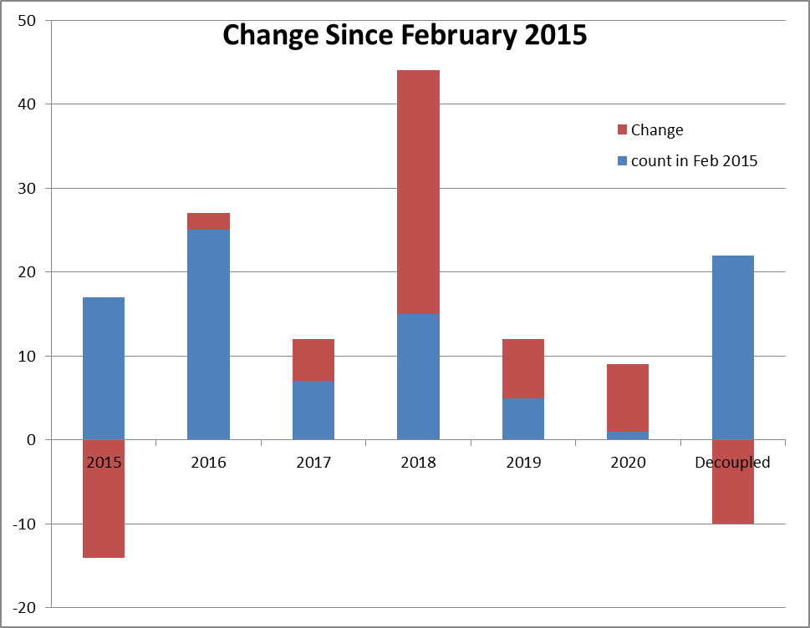
Tech Roadmap Oct. 2015
Mostly driven by T1xx

Slide 8
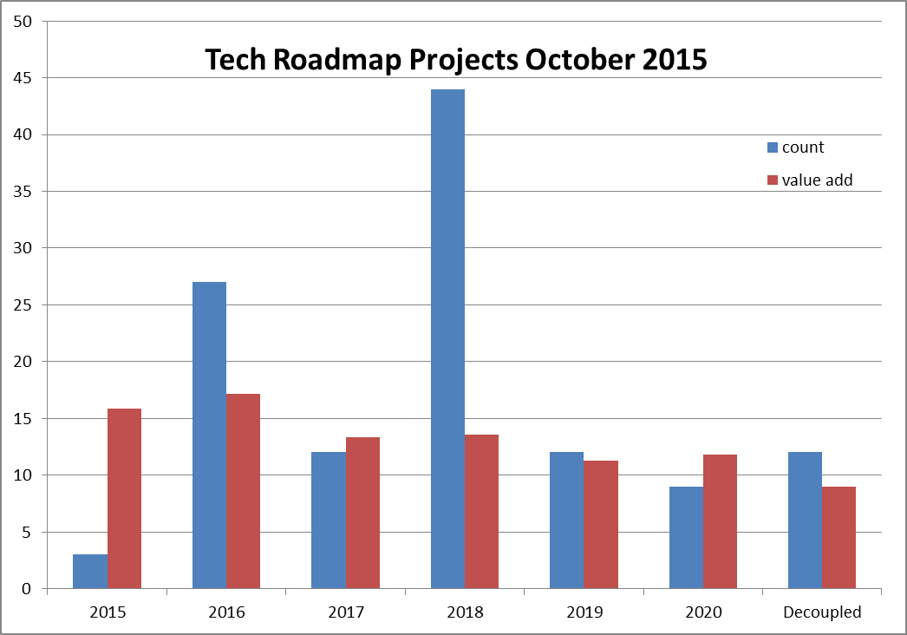
Tech Roadmap Oct. 2015

Slide 9
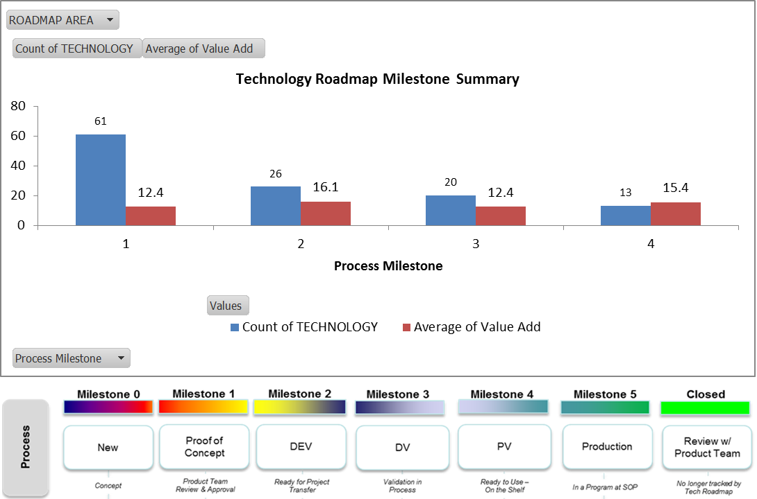
Tech Roadmap Oct. 2015

Slide 10
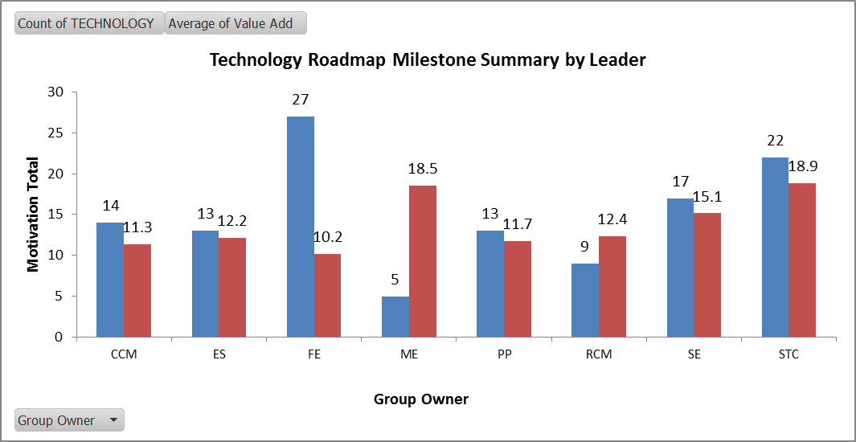
Tech Roadmap Oct. 2015

